Slide 1



Boardroom Conflict, Paralysis or Engagement :
ADVANCED LEADERS
AT
MASSEY BUSINESS SCHOOL

Slide 2
Conflict, Paralysis or Engagement:
Critical Nature of Boardroom Dynamics:
Andrew Kakabadse
Professor of Governance and Leadership
Henley Business School

Slide 3
Shaped by:
Discretionary Action
  Oversight
  Stewardship
  Compliance
Boards Add Value?
  NEDs add value?
  Competitive advantage
  Differentiation

Slide 4
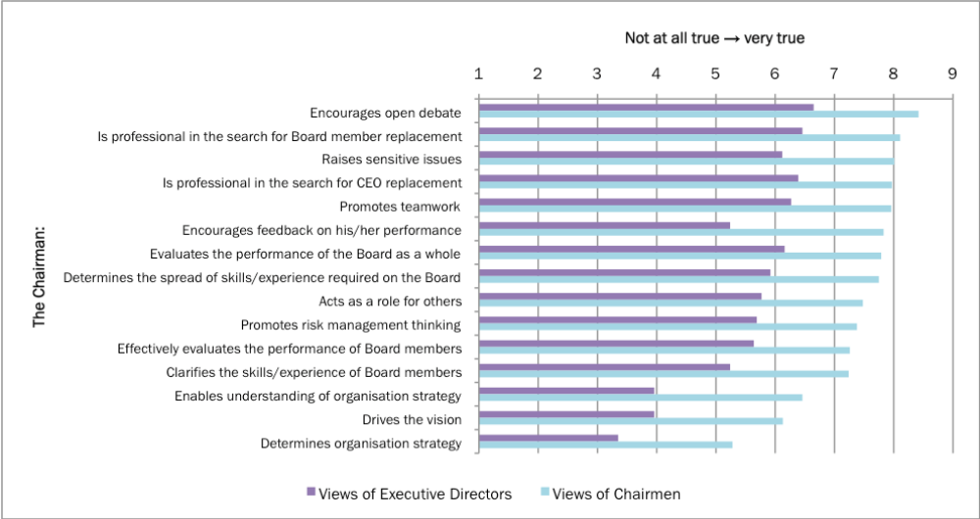
Board Dynamics (UK)
Executives v NEDs
/NEDs
LOW TRUST – Executive Board Directors of Chairman/NEDs
27 Sep 11

Slide 5
Board Dynamics (USA)
Average Companies (Majority)
High inhibition
Defensiveness
Limited use of NED/external director capabilities
Appointed from network
Discouraged from talking to
  Staff/Management
External Director portfolio extensive
Strategy/board dynamics driven by CEO / President / Chairman
Dismissive of CSR
NOT DEVELOPMENT MINDED
Legal culpability
Sarbanes Oxley
  Gone too far
  May induce more ‘corruption’
Global Board Best Practice

Slide 6
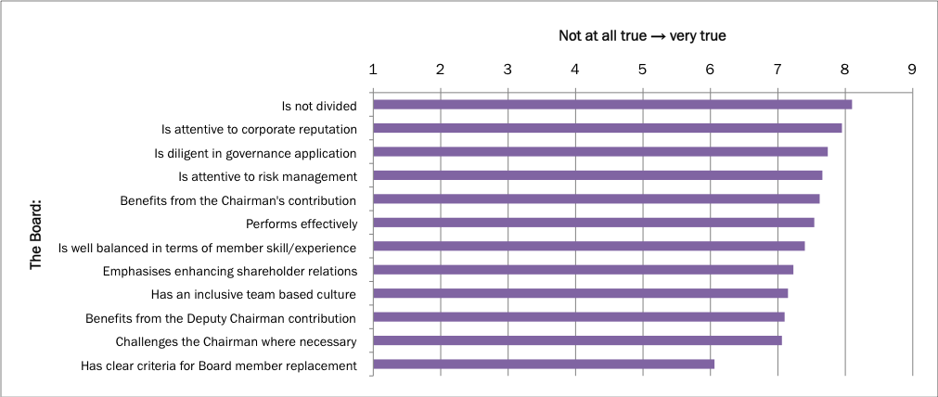
Board Dynamics (Australia)
Board Performance - Shared/cohesive views

Slide 7
Director Capability
  Scrutiny
  Compelling argument
  Engaging across misalignments
  Resilience
Chairman
  Bad Chairman Bad Board
  Good Chairman Good Board
  UK Government Study
  Need dynamic governance

Slide 8
Outcome
Paralysis too many times
Compliance with stewardship
Diversity of thinking
Board deep into Enterprise – Why?
Working through fault lines
Sustainability

Slide 9

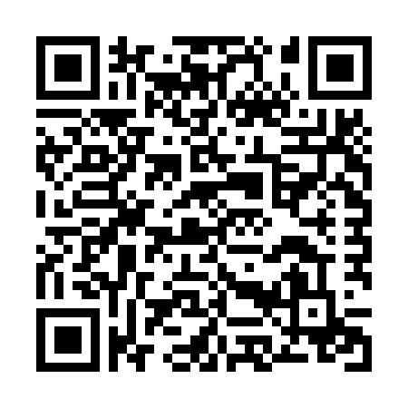
Feedback Please
Conflict, Paralysis or Engagement
https://www.surveygizmo.com/s3/4489388/Advanced-Practice-Gaining-an-Edge-Boardroom

